Slide 1
MISA Coding Competition
Eric Lu, Jason Lan, Anirudh Vadrevu, Michael Sheppard, Jordy Tello

Slide 2
Outline
Overview
Problem
Dashboard
Statistical Analysis
Conclusion

Slide 3

Overview
1

Slide 4
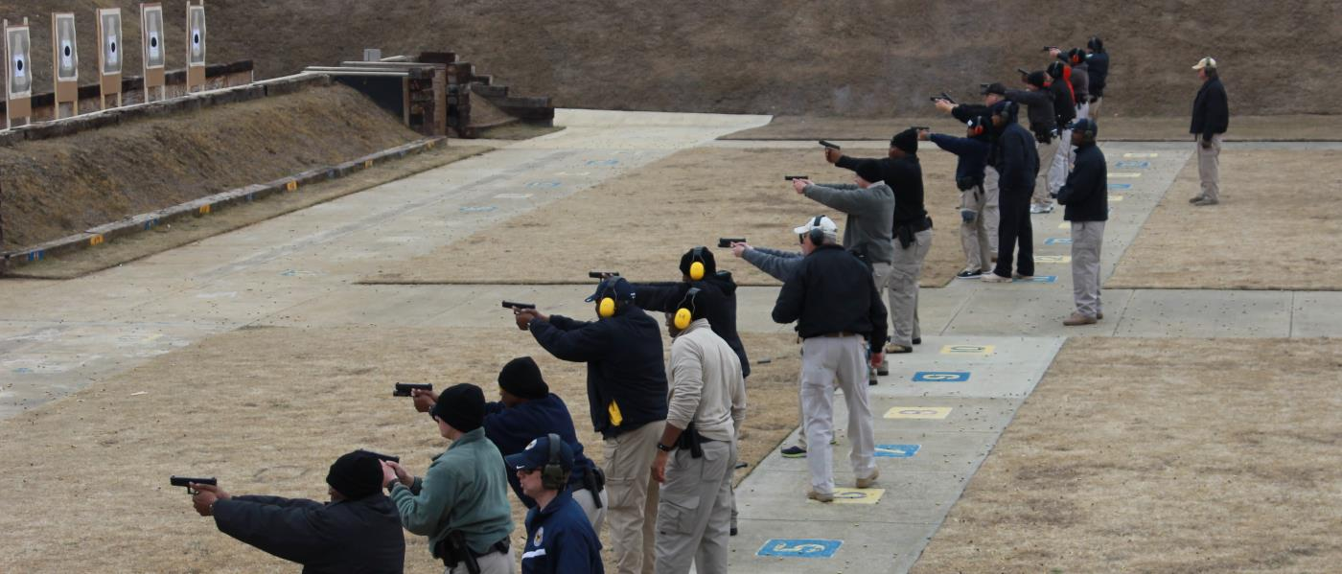
Gun Culture
36%-49% of American Household own Guns
60% of Americans own guns for protection purpose
-Gallup 2014

Slide 5
Problem
2

Slide 6
Problem
Problem with gun violence in America or our emotional selectivity?
Statistical outlier or part of trend?
What possible solutions exist?
Overview
Problem
Solution
Business Model
Conclusion

Slide 7
Solution
3

Slide 8
Rule of Law
Use gun laws to reduce the amount of arms being purchased
Statistical Analysis shows that gun laws are effective
These laws must target gun types. Weapons like shotguns should require higher standards before purchase

Slide 9
Dashboard
https://michaelsheppard8.wixsite.com/website

Slide 10

Statistical Analysis
4

Slide 11
Data
Wikipedia “List of countries by firearm-related death rate”
Country, Year
Total, Homicides, Suicides, Unintentional, Undetermined
Guns per 100 inhabitants
Ex.
Country | Year | Total | Homicides | Suicides | Unintentional | Undetermined | Guns per 100 inhabitants
United States | 2016 | 11.96 | 4.62 | 7.1 | 0.15 | 0.09 | 101.05

Slide 12
Cleaning data
Parsing - Guns per 100 inhabitants
8.8 (2010)
13.70
30.4 (2007?)
6.2-19.4 (2007, 2006)
9.9–11.24 (mixed years)
?
2.8 [76]
Parsing - Country Name
Weird spaces before or after country names
Unable to compare or do data analysis

Slide 13
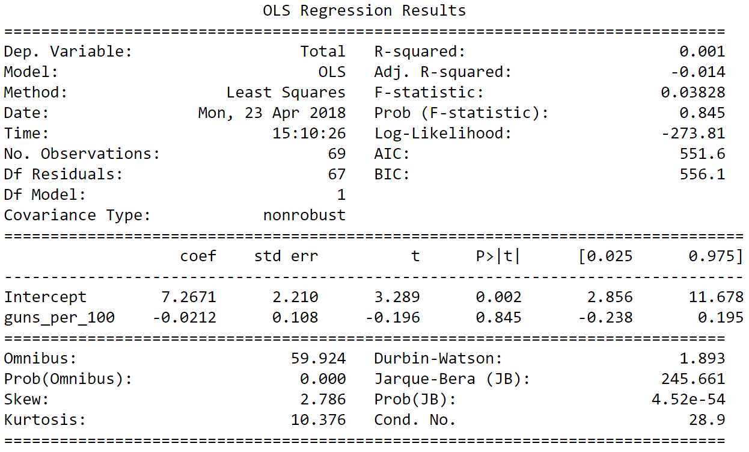
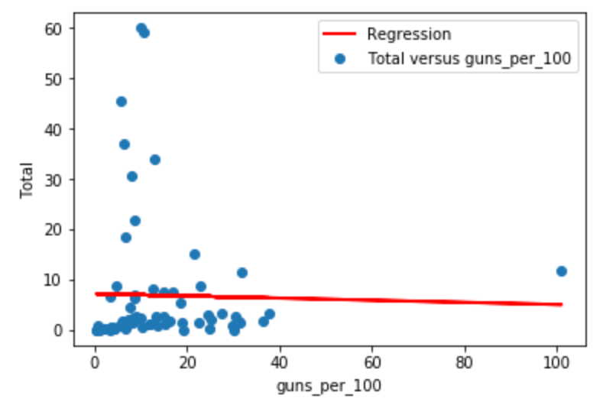
Ordinary Least Squares (OLS) Regression model
All Countries

Slide 14
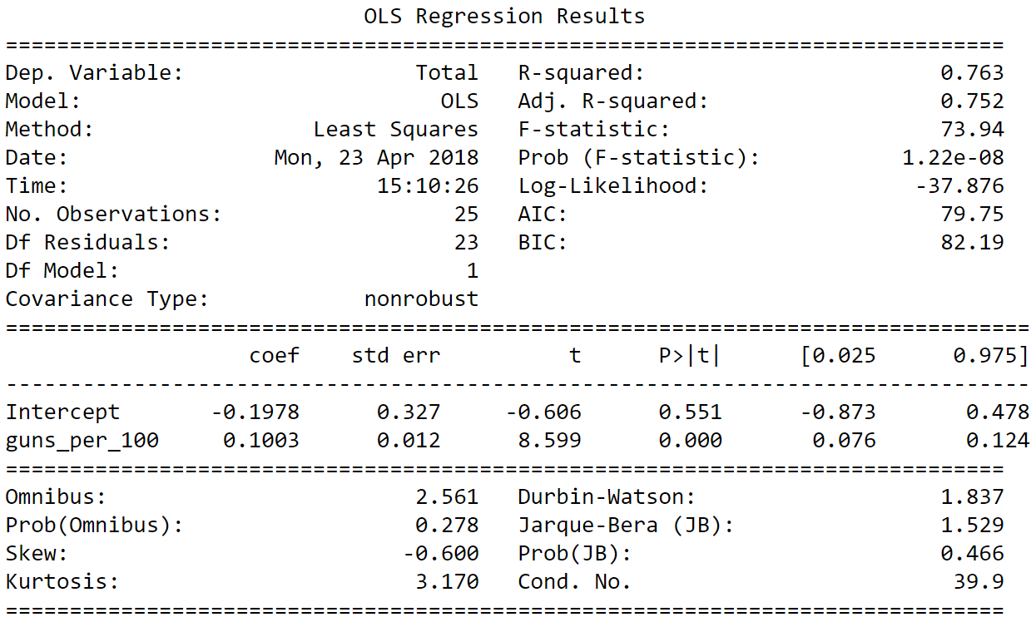
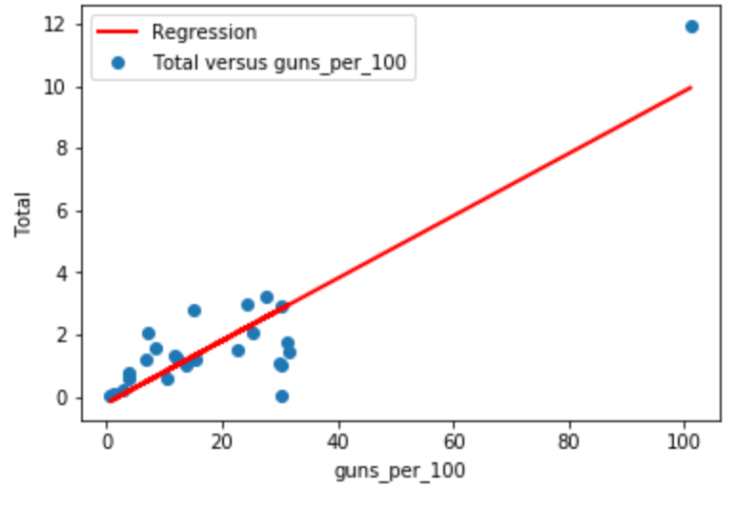
Ordinary Least Squares (OLS) Regression model First World Countries

Slide 15
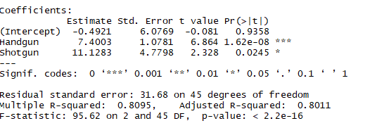
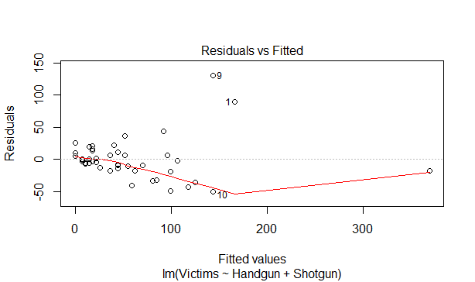

Gun Violence Gun Type Analysis

Slide 16
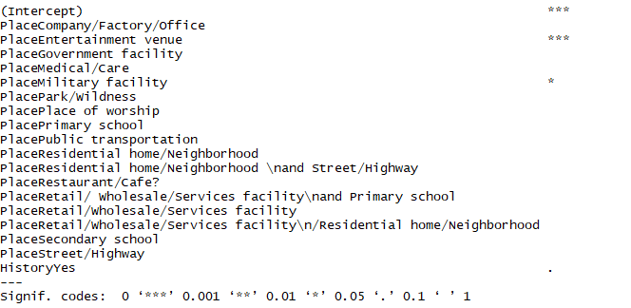
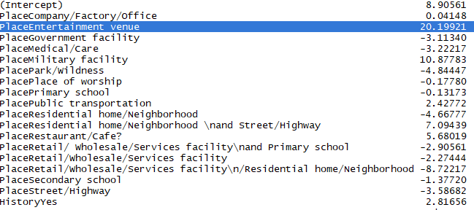
Solution: Mental Health Investment (PTSD)

Slide 17
Solution: Mental Health Investment (PTSD)
Investments should be made in mental health
Specifically, this should be made in reducing the negative effects of PTSD
Urge Congress to better fund VA Hospitals

Slide 18
Conclusion
5

Slide 19
Brief Review
The United States outpaces other developed nations in gun violence
States are capable of finding success when enacting gun laws
Guns of higher caliber do indeed cause signifcantly more deaths
A history of mental health issues significantly increase mass shooting casualties
Overview
Problem
Solution
Business Model
Conclusion

Slide 20
Thank you!

